Slide 1
Guess what is the topic today

Slide 2
what's your favorite drink?
Coca-Cola
milk tea
tea
alcohol
juice
water (Deit of water and love?)

Slide 3
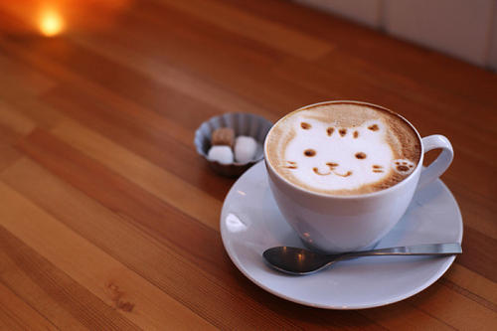
Coffee

Slide 4
when and what's your feeling when drink coffee first time ?
bitter （苦涩的）
sweet
happiness
refreshing （提神的）

Slide 5
how coffee is made?

Slide 6
1. Planting
2. Harversting the cherries(picking)
3. Processing the Cherries
i. Dry Method
ii. Wet Method
4. Drying the Beans(2-3 weeks)
5. Milling(hulling)去皮 the Beans
6. Exporting(sorting) the Beans(accoring the size)
7. roasting(焙烧)
https://www.youtube.com/watch?v=HCx6FEvjIng

Slide 7
Coffee recognition

Slide 8
美式浓缩咖啡Espresso
康宝蓝Espresso Con Panna
美式咖啡Americano
拿铁咖啡Caffè latte
卡布奇諾Cappuccino
摩卡咖啡Café Mocha
焦糖瑪奇朵Caramel Macchiato
爱尔兰咖啡Irish Coffee
維也納咖啡Viennese coffee

Slide 9
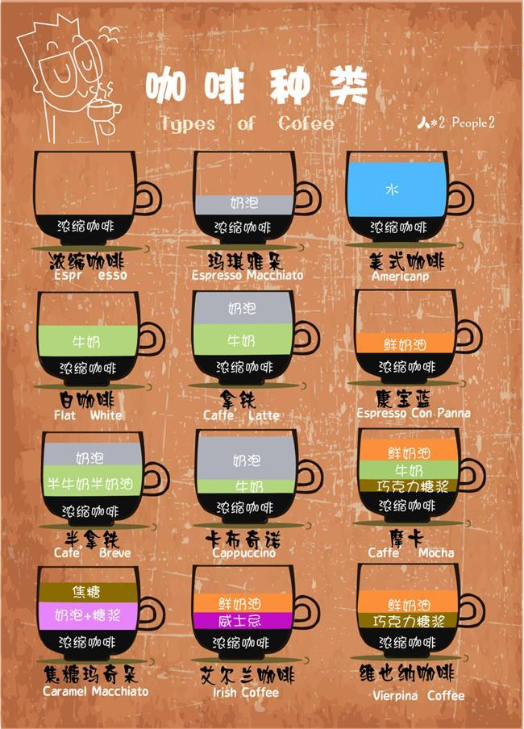

Slide 10
why coffee are more and more popular in CHINA? (especially for the central city)

Slide 11
Much of China’s younger generation is coming of age surrounded by Starbucks
Young people like new things
morden people's High-intensity work.
more and more people want to make profit from coffee market
then more advertising and coffee product is appear.

Slide 12
more for coffee
why do you like coffee ?
what do you learn from coffee ?

